Slide 1
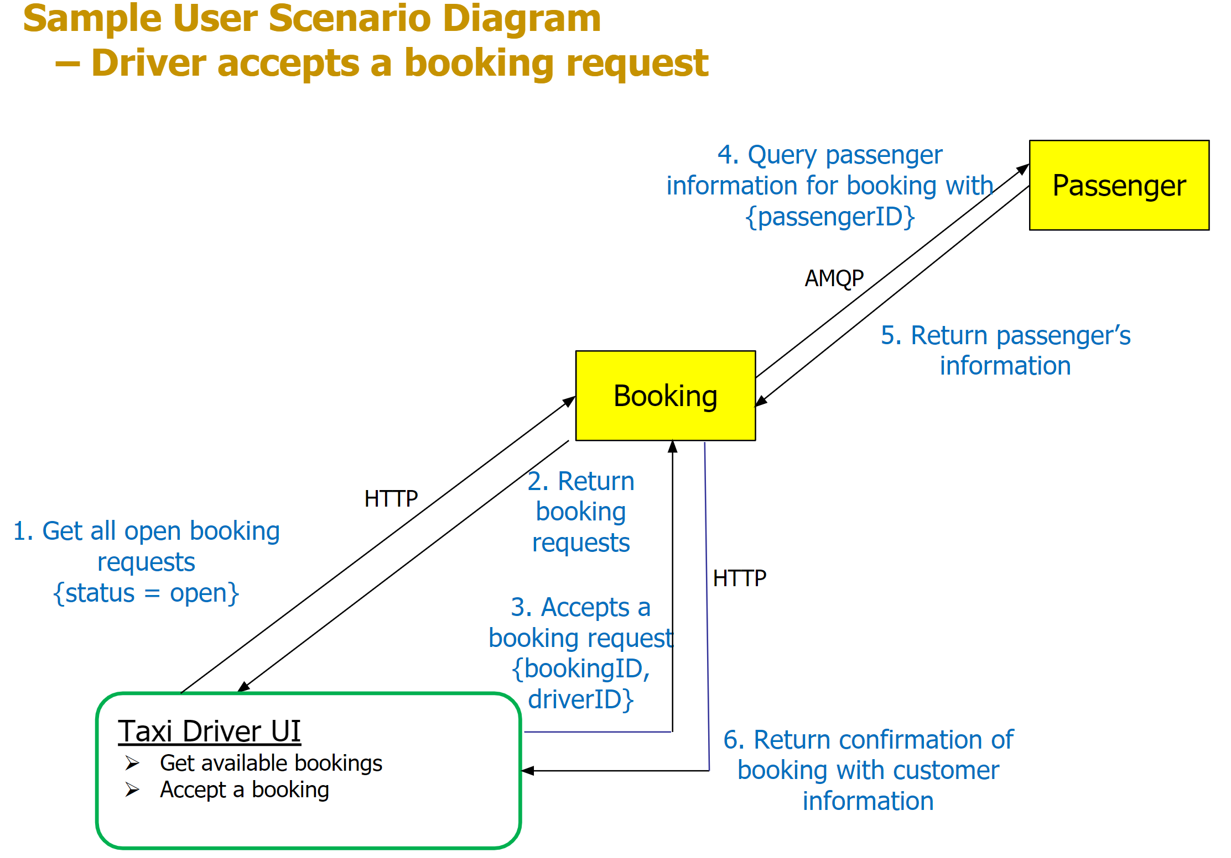

Slide 2
2. Create a new booking based on
customer’s chosen slot
[POST]
Customer UI
3. Return confirmation of booking creation.
4. Redirect page to booking page.
Booking
1. Get a list of service providers and services
[GET]
Service Provider

Slide 3
2. Return the list of bookings for the customer
Booking
Get a list of service Bookings of the Customer
[GET]
Customer UI
3. Make payment for booking
{booking_id, booking_price, provider_id} [POST]
4. Use Stripe API to make payment
{booking_id, booking_price, provider_id}
[POST]
6. Return the payment request status to the UI.
Payment
Stripe API
5. API returns the status of the payment request that is made.

Slide 4
1. Get the list of payment that belongs to the service provider
[GET]
Service Provider UI
Payment
2. Return the list of payments made to service provider.

Slide 5
1. Get all open bookings
[GET]
Service Provider UI
2. Return list of open bookings
Booking
4. Return customer information
Customer
3. Get customer information
[GET]

Slide 6
1. Get all open bookings
[GET]
Customer UI
2. Return list of closed bookings
Booking
4. Return review creation status
Review
3. Create a review for the booking
{booking_id, review_star, review_comment}
[POST]

